Slide 1

18th Annual Consortium Meeting
April 21, 2014
MAURA PUERTO
JOSE LOPEZ SALINAS
CLARENCE MILLER
GEORGE HIRASAKI
Most of the Work Done by
  HAO HELEN ZENG
  ANGELICA GARCIA
  ANDRES NOVOA
PROPERTIES OF FORMULATION
FOR GENERATING
ULTRA-LOW_TENSION and STRONG FOAM
1

Slide 2

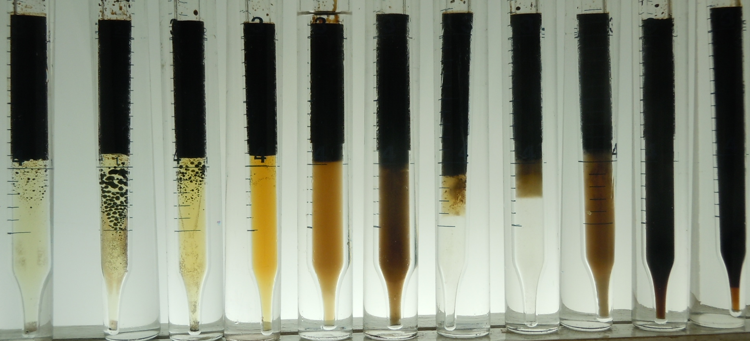
1% Lauryl Betaine / IOS₁₅₋₁₈ ENORDET 0332
Blend scan in SeaWater with Synthetic Live Oil_100°C, WOR~1
SO₃-Na SO₃-Na
R-CH₂-CH₂- CH –CH -CH₂-CH₂-R’ ⁺ R-CH₂ – CH-CH= CH-CH₂-R’
OH
LB 9/1 8/2 7/3 6/4 5/5 4/6 3/7 2/8 1/9 IOS
it has potential to have low IFT

Slide 3
Aqueous Phase Map: 1% LB/ IOS₁₅₋₁₈ in SW

Slide 4
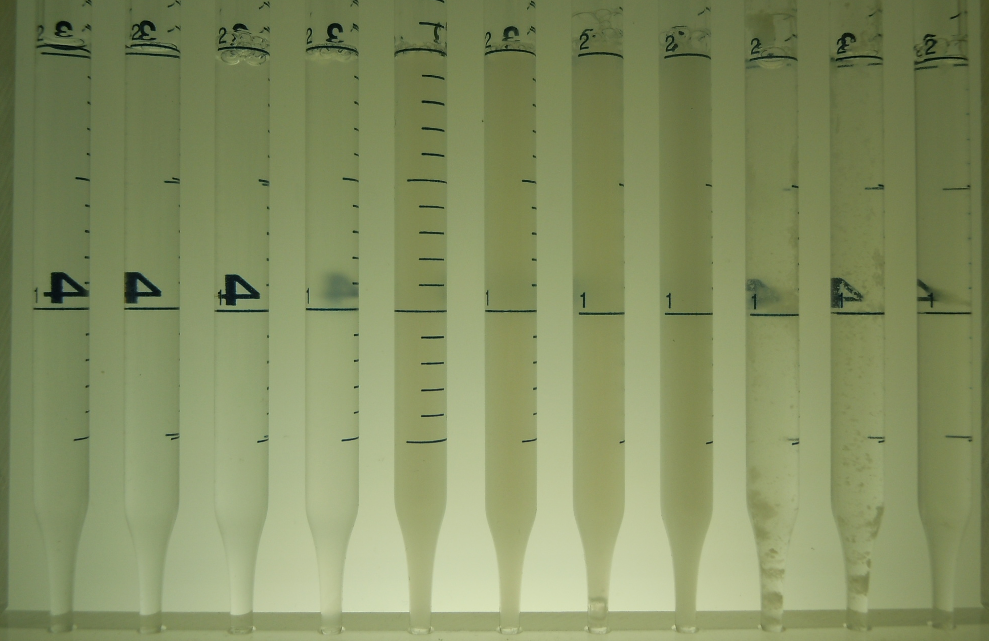
1% LB/ IOS ₁₅₋₁₈
Blend scan in SeaWater ~25°C
LB 9/1 8/2 7/3 6/4 5/5 4/6 3/7 2/8 1/9 IOS

Slide 5
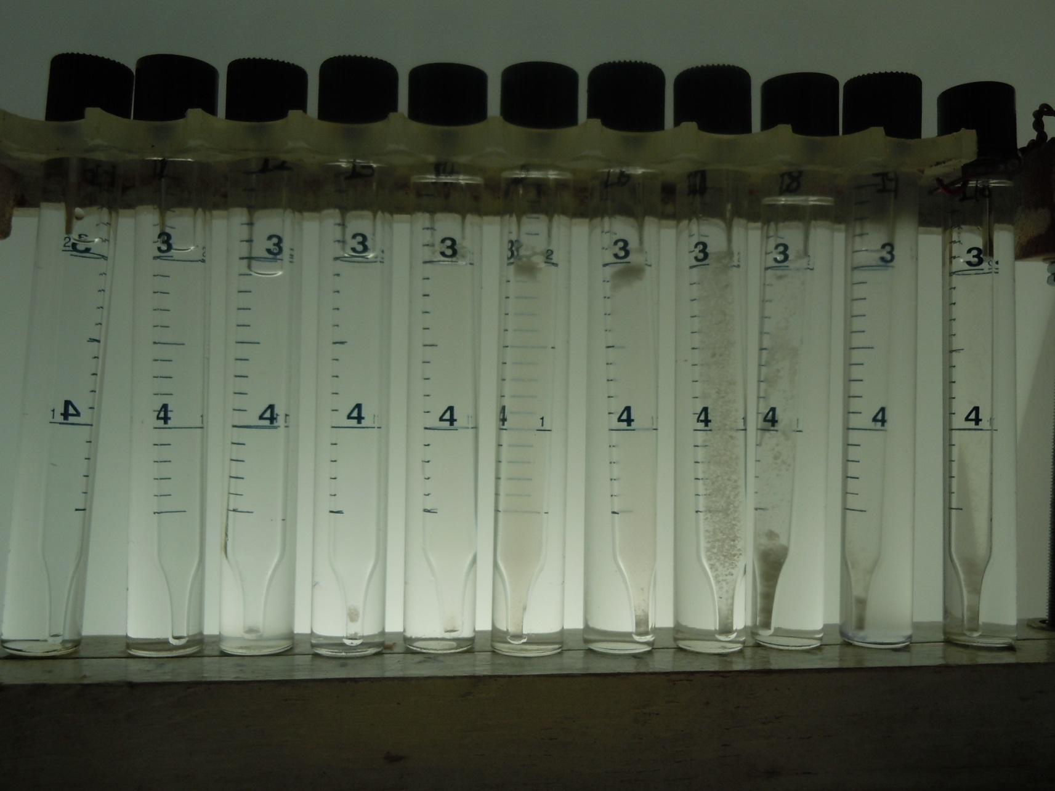
1% LB/IOS ₁₅₋₁₈
Blend scan in SeaWater 100°C
LB 9/1 8/2 7/3 6/4 5/5 4/6 3/7 2/8 1/9 IOS
Precipitates

Slide 6
Aqueous Phase Map: 1% LB/IOS₁₅₋₁₈ in SW

Slide 7

Criteria for adding a third Surfactant
For eliminating precipitates while preserving foamability and low tension in the blend of 5/5:LB/IOS with potential to generate ultra low IFT at elevated temperature (100°C),
it was realized that the third surfactant must meet this important criterion:
  HLB of 3thsurfactant must decrease with temperature or in other words, be more hydrophilic at ambient temperatures than at elevated temperatures but also has to be
  Hydrophilic enough at both low and high temperature to promote surfactant-brine compatibility in the absence of oil
  Hydrophobic enough at elevated temperature for promoting ultra low IFT
  Thermally stable.
  Two Surfactants appeared to meet criterion
  Tridecyl alcohol > three times ethoxylated and carboxylated = L38
  Tridecyl alcohol- five times propoxylated-eight times ethoxylated-carboxylate = N58
Hypothetical Case
Phase Inversion Temperature

Slide 8
1 % (5:LB/5:IOS) + 0.12% L38
Adding 0.12 % to 0.5% LB + 0.5% IOS resulted in an equimolar zwitterionic – anionic mixture
-
+
-
-
+
-
-
IOS⁻
+
-
LB±
-
+
-
-
+
-
-
L38 ⁻
+
-
Self-assembly of Alkoxylated in Solutions may also help on the elimination of precipitates

Slide 9
Tests and Results: Effect of Adding L38 & N58 to 5:LB/ 5:IOS
IFT lowered to ultralow values at L38 = 0.12% & N58 = 0.04% ; minimum required for making 0.5%LB+0.5% IOS in SW free of precipitates (10 11 12)
Frontal Dilutions at 10% intervals of 1% (5:LB+5: IOS) + 0.12 %L38 in Sw with FB were apparently free of problems (13 14)
Blend Scan Phase behavior with SW, FB _WOR~ 1 @ 25°C, 100°C
  Increasing L38 [0.1-0.25-0.5%] while keeping LB/IOS constant makes system more hydrophilic at 25°C but at 100°C changes are imperceptible ; perhaps oil solubilization increased without drastic changes in phase behavior (SW 15 _{0.5-25C} FB 16) --- (SW 17 _{0.5 100C} FB 18)
Salinity Scan from SW to FB at 10% interval : (19 _{100C})
1% (5:LB / 5:IOS C₁₅₋₁₈) + 0.12% L38 or 2% (5:LB / 5:IOS C₁₅₋₁₈) + 0.24% L38
Increasing salinity from SW to FB produced a monotonically change in phase behavior I-III-II
Foam-Flow Behavior similar to those previously accepted (20)

Slide 10
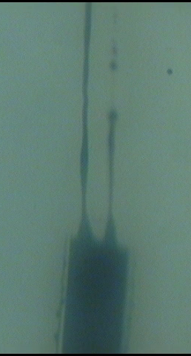
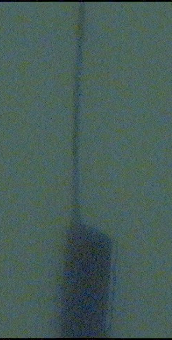
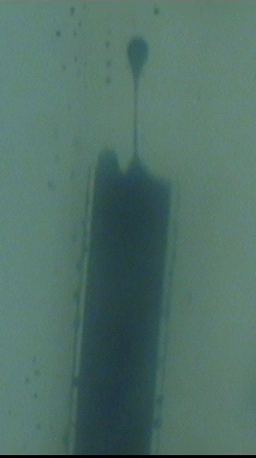
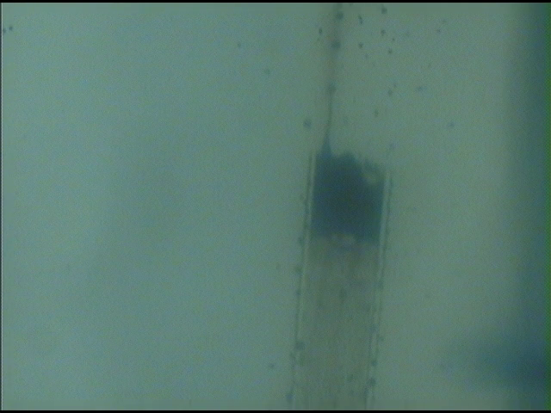
1% (5:LB/5:IOS) + 0.12% L38 in SeaWater at 100°C
Displacing oil from an oil-wet capillary filled with SLO and immersed in Solution
Time increasing IFT ~ 4 X 10⁻⁴ Dynes/cm

Slide 11
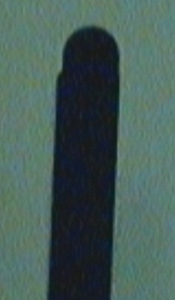
Comparison of IFT values without and with a 3th Surfactant
L38
Without With
Formulation | 1% 7.5:LB/2.5:IOS | 1 % (5:LB/5:IOS) + 0.12% L38
 | IFT Dynes/cm at 100°C in sea water
 | 2 X 10⁻¹ | 4 X 10⁻⁴

Slide 12
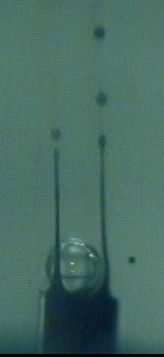
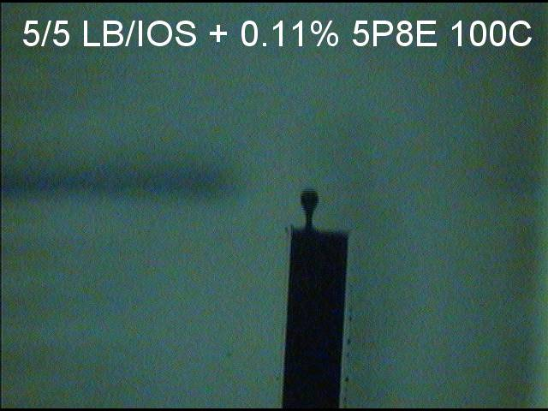
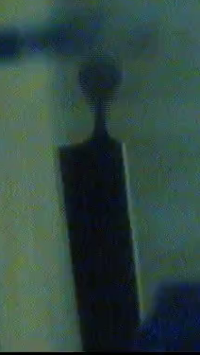
Effect of adding an excess of a 3th Surfactant
N58
IFT increasing
% N58 0.04 0.11 0.3
Figure 9 IFT comparison of initial emerging-drop behavior at 100°C for different additions of N58

Slide 13
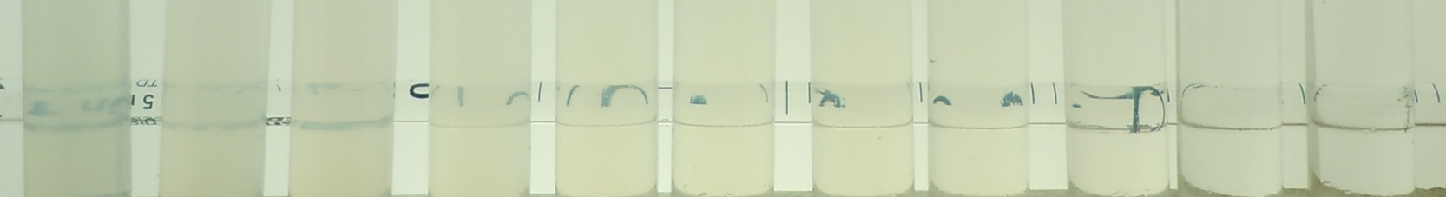
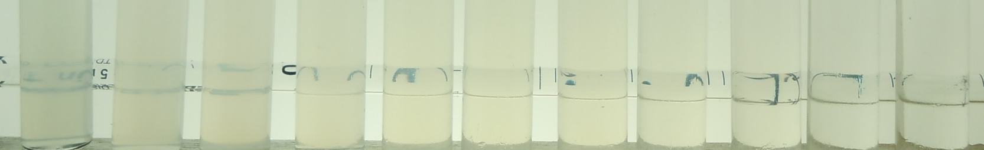
Frontal Dilutions of 1% (5:LB / 5:IOS C₁₅₋₁₈) + 0.12% L38 in SW with FB
25°C
100°C
SW 9/1 8/2 7/3 6/4 5/5 4/6 3/7 2/8 1/9 FB
From Translucent to Clear
Graduate glass pipette in background for assessing clarity of markings thru solution

Slide 14
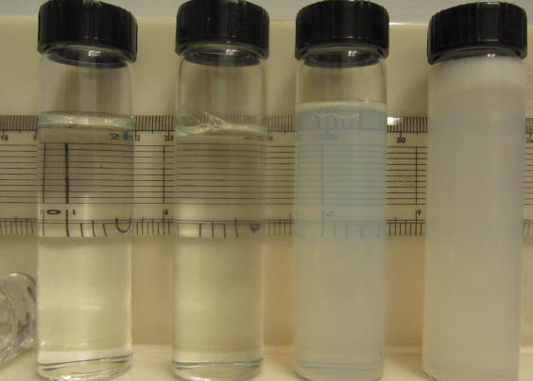
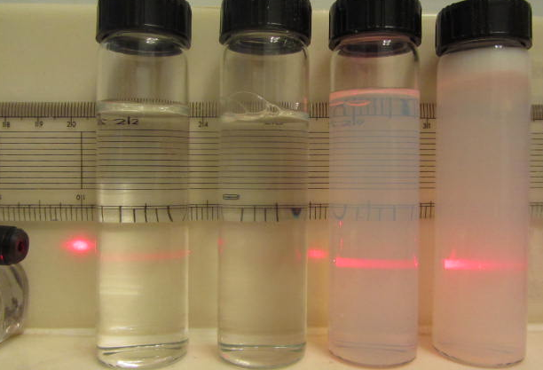
.5 AOS DI H₂0 1%LT
Suitable Injection Composition
Filters thru 0.2 micron without losing surfactant concentration
Clear Translucent Cloudy
Scatters light

Slide 15
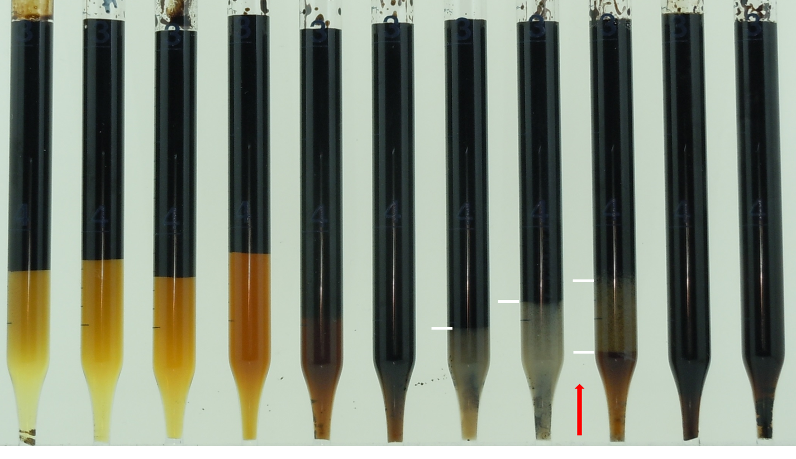
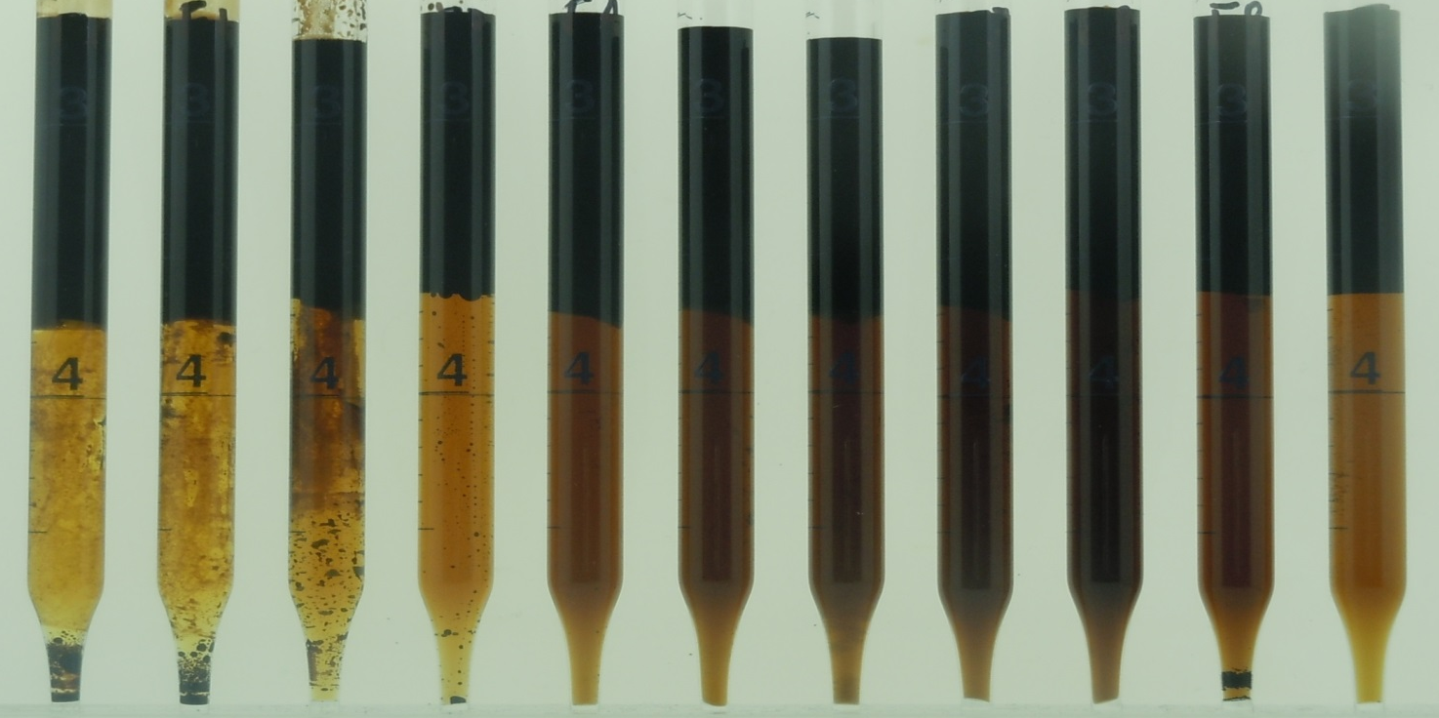
Blend Scan in Sea Water 25°C %oa
LB 9/1 8/2 7/3 6/4 5/5 4/6 3/7 2/8 1/9 IOS
CONTROL :
2% (5:LB/5:IOS₁₅₋₁₈ )
2% (5:LB/5:IOS₁₅₋₁₈)
+
0.5% L38
0.5% L38 makes system more hydrophilic @25°C

Slide 16
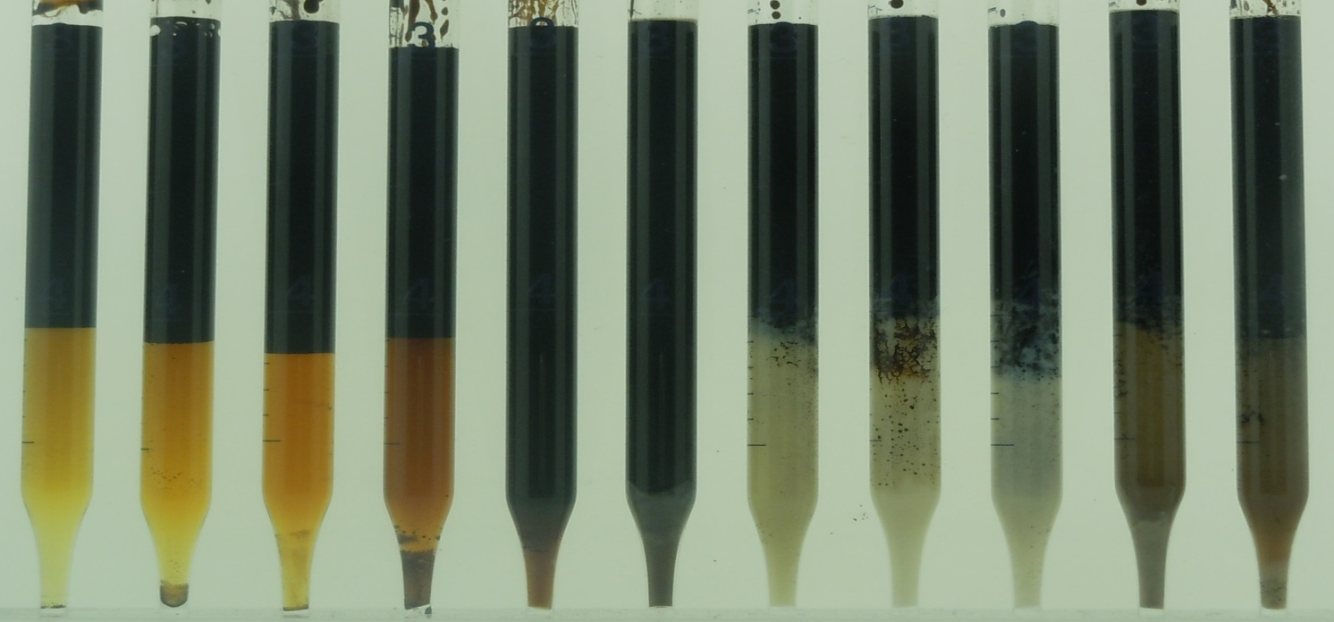
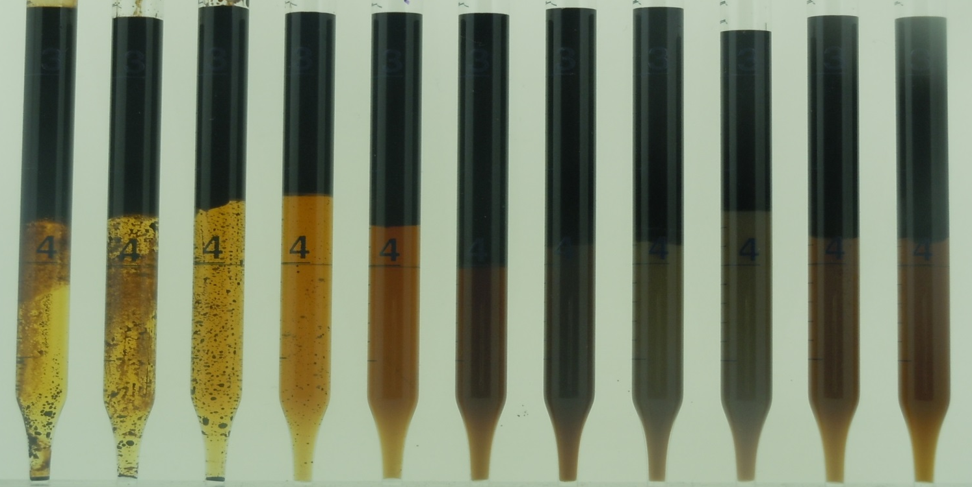
Blend Scan in FB ~ 25°C %oa
LB 9/1 8/2 7/3 6/4 5/5 4/6 3/7 2/8 1/9 IOS
CONTROL :
2% (5:LB / 5:IOS ₁₅₋₁₈)
2% (5:LB/5:IOS₁₅₋₁₈)
+
0.5% L38
L38 makes system more Hydrophilic @ 25°C

Slide 17
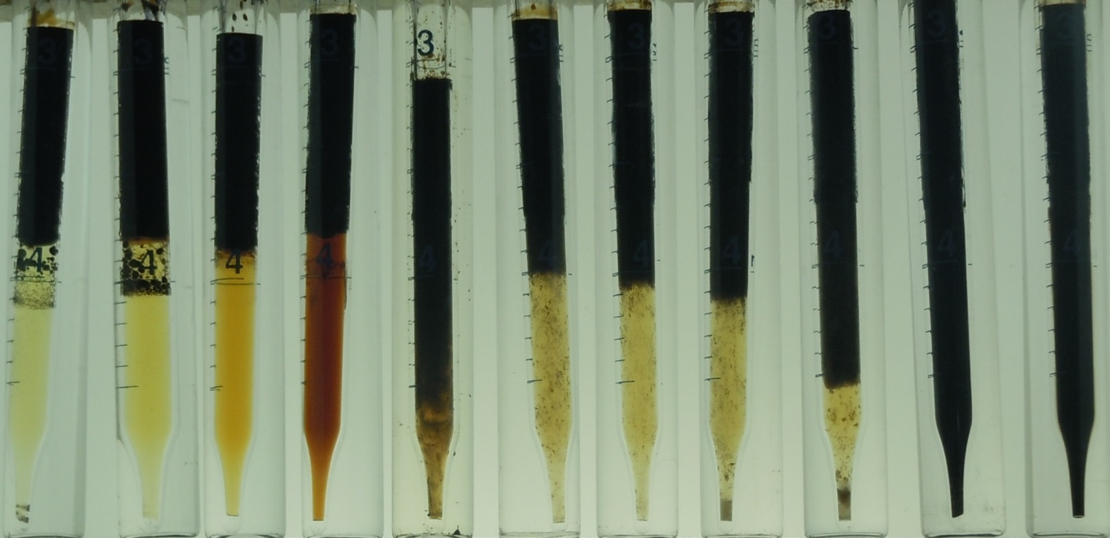
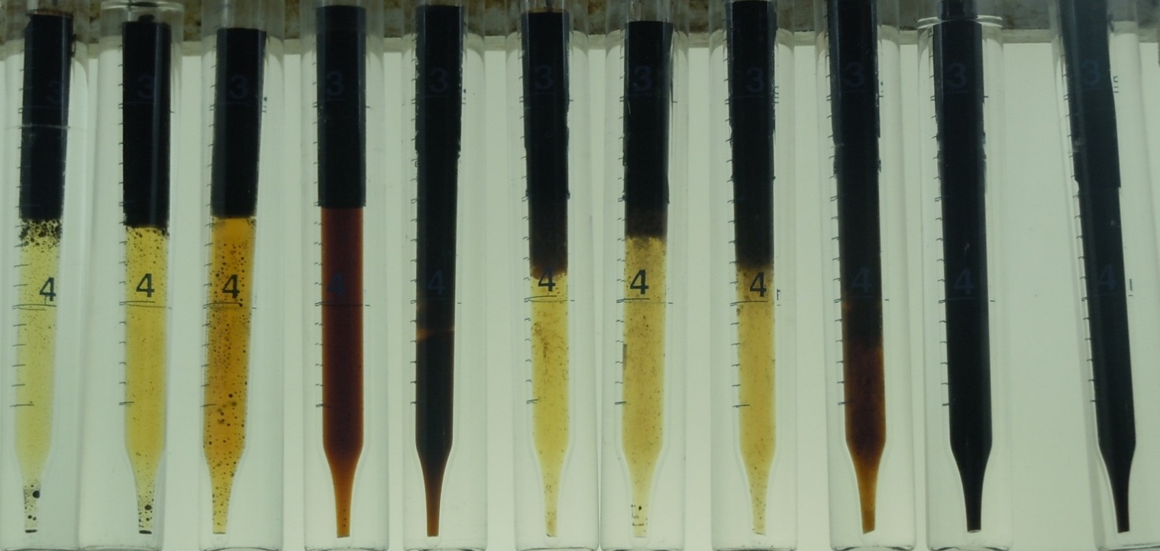
Blend Scan in Sea Water ~ 100°C %oa
LB 9/1 8/2 7/3 6/4 5/5 4/6 3/7 2/8 1/9 IOS
CONTROL :
2% (5:LB / 5:IOS ₁₅₋₁₈)
2% (5:LB / 5:IOS ₁₅₋₁₈)
+
0.5% L38
Changes are practically imperceptible @ 100°C;
perhaps more oil is solubilized

Slide 18
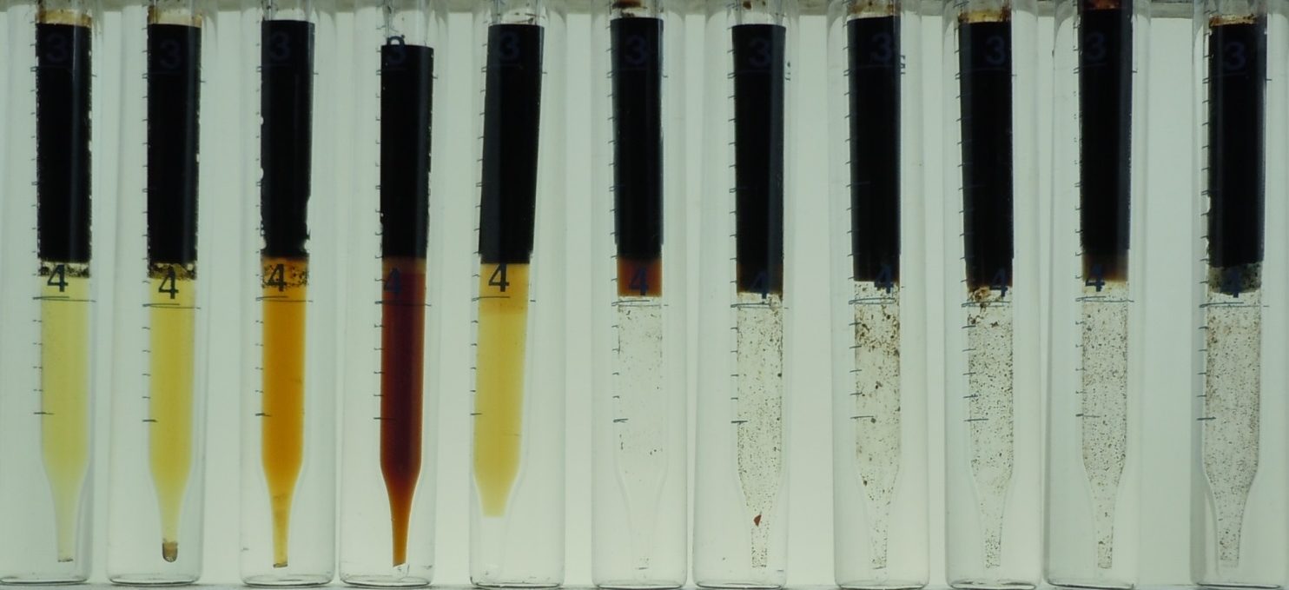
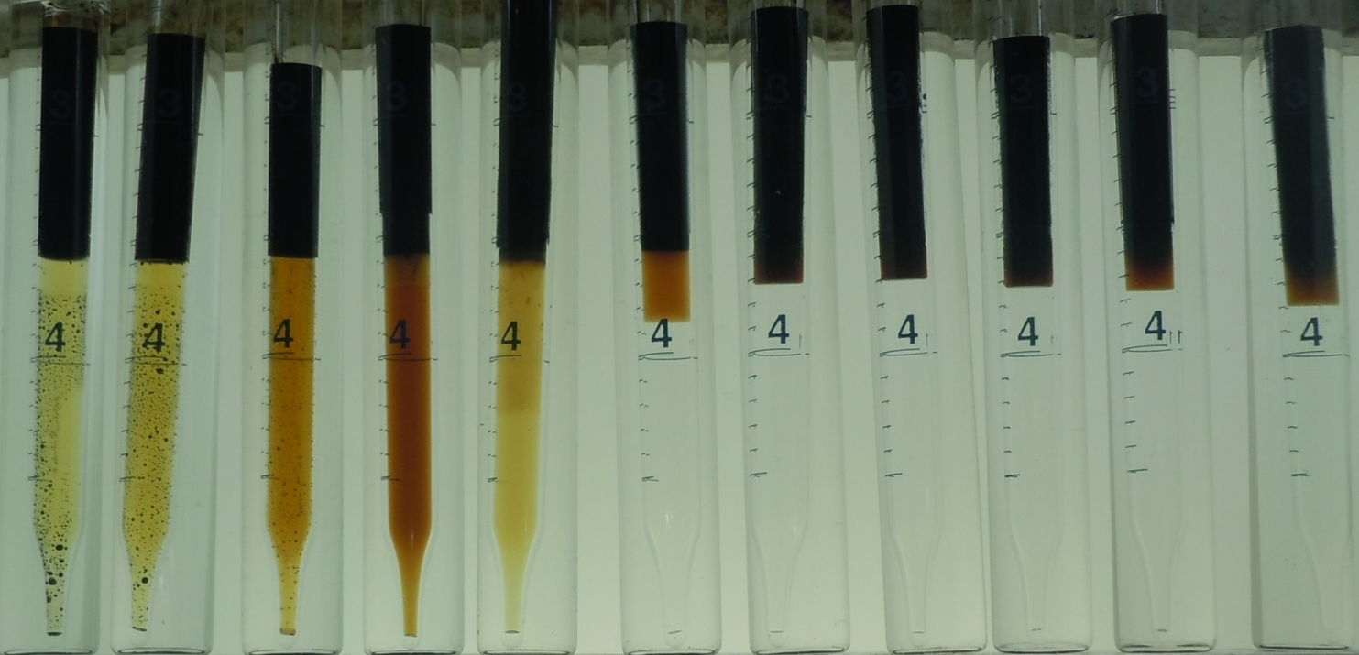
Blend Scan in Formation Brine ~ 100°C %oa
LB 9/1 8/2 7/3 6/4 5/5 4/6 3/7 2/8 1/9 IOS
CONTROL :
2% (5:LB / 5:IOS₁₅₋₁₈)
2% (5:LB / 5:IOS₁₅₋₁₈)
+
0.5% L38
Changes are practically imperceptible @ 100°C
@FB , Bø ~ 7/3
@ SW, Bø ~ 5/5 in slide 2

Slide 19
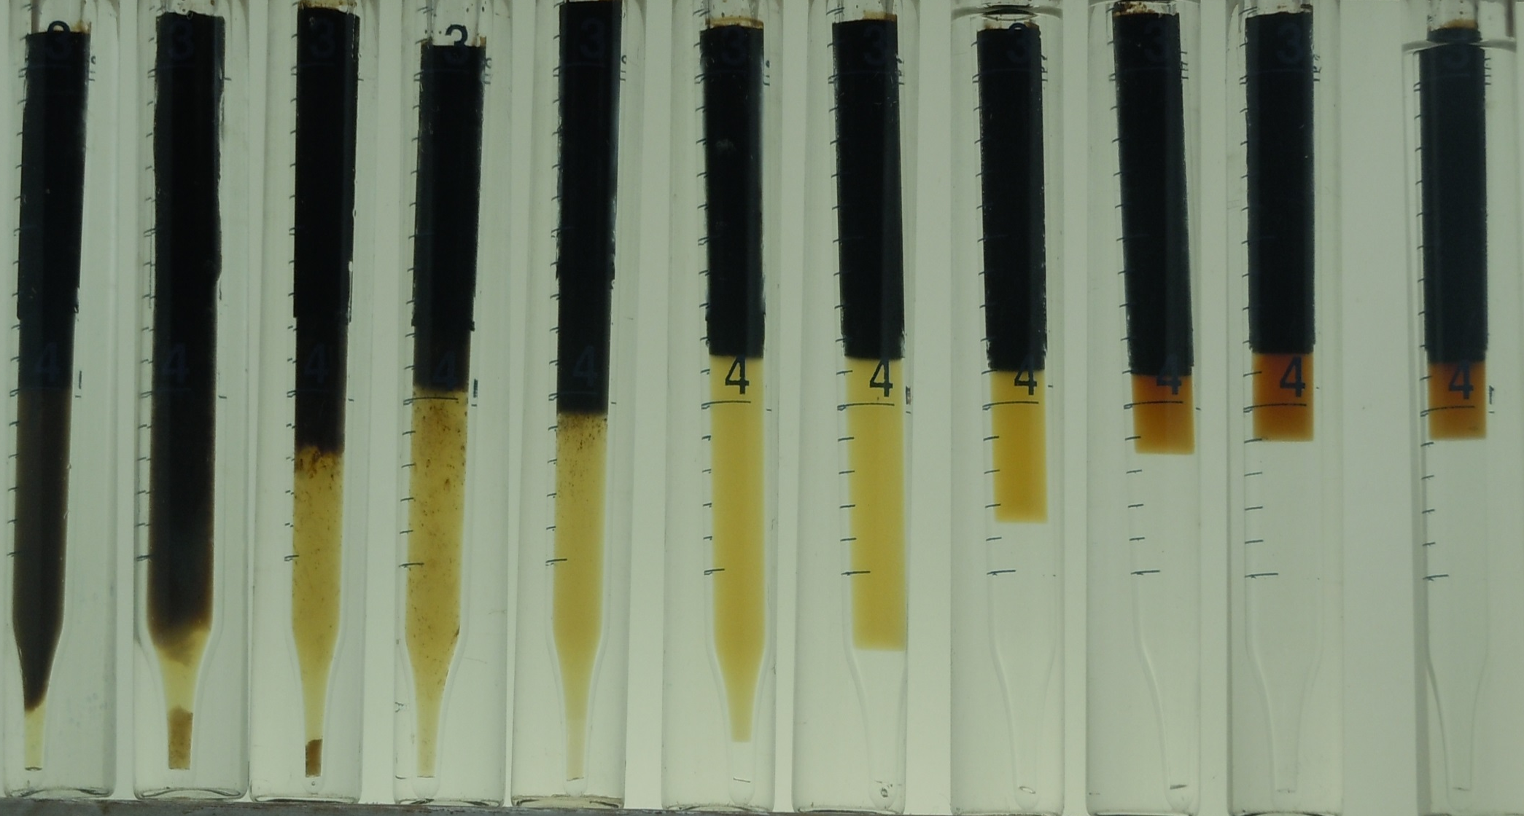
Salinity Scan 1% (5:LB / 5:IOS C₁₅₋₁₈) + 0.12% L38
from SW to FB with Synthetic Live Oil @100°C
SW 9/1 8/2 7/3 6/4 5/5 4/6 3/7 2/8 1/9 FB

Slide 20
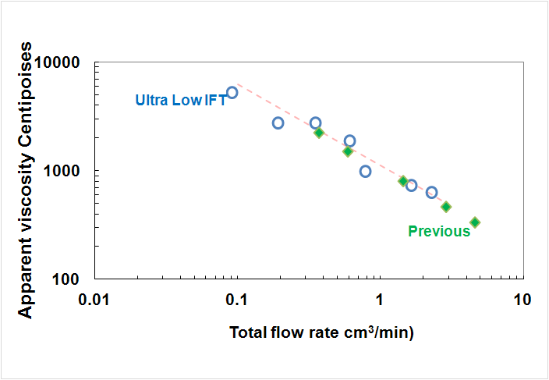
Comparison of Foam-Flow Behavior @ 80% Foam Quality :
Ultra-Low IFT 1% (5:LB/5:IOS) +0.12% L38
with previous
1% 7:LB/3:AOS₁₆₋₁₈

Slide 21
Conclusions 1 of 2
Addition of a third surfactant is an idea submitted for Patent : It makes the Optimal “Unclear” Solution-Blend of two surfactants SUITABLE for injection without hindering its
Low-tension properties in the presence of oil
Strong-foam generation properties inherited from the two other surfactants in the Blend, which produced strong foam at a more hydrophilic ratio but without lowering IFT to ultra low values of 10⁻³ Dynes/cm

Slide 22
Conclusion 2 of 2
  Phase Behavior Test Results of adding a third surfactant
  WOR~1
  L38 makes LB/IOS blend more hydrophilic at 25°C but at 100°C system somewhat more lipophilic without a drastic change in phase behavior
    At 25°C, effect is pronounced at 0.5% but perhaps imperceptible at 0.1%
    At 100°, effect is less pronounced at all tested concentrations: more oil appeared solubilized without a drastic change in phase behavior
Salinity Scan SW to FB
No adverse behavior of formulation dilutions in the absence of oil (slide 13)
Middle phases observed from 9 SW/1 FB to 6 SW/4 FB
Slide 19

Slide 23
THANKS TO PEMEX FOR FUNDING
THANKS YOU ALL FOR COMING
ANY QUESTIONS ?
END
END
END

